Slide 1

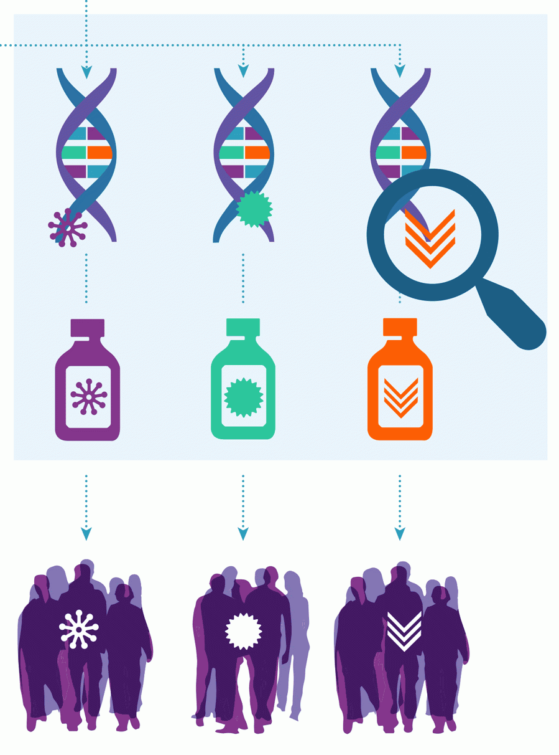
The Heavy Lifting Treatment Helper (HeaLTH): Streamlining the Clinical Trial Selection Process
Team Members:
Jeremiah Roland, Sree Nukala, Jin Cho,
Misagh Mansouri
Center for Urban Informatics & Progress
University of Tennessee, Chattanooga

Slide 2
Approach:Cancer clinical trial matching using medical descriptions text mining
Clinical trial (given dataset)
Brute Force Logic
Participents data (dataset-2)
Eligibility criteria data set(dataset 1)
Clustering
Conditional Logic
Concatenate all 7 files and match with the conditional logic output
Get trial NCIT
Separate NCIT
(code, compOp, value)
Output
100 Patients Medical History
Take the description of the matched trials for patient
Repeate for all 100 patients
Swap code for patient’s data
Aggolmerative clustering on description.
Log(sample data) = no.of clusters
Evaluate Conditional
False
True
Extract key most repeated key word from all clusters
Add trial to list
Notes:
Iterate through trial list
NCIT: the conditional statement
Code: c-code
compOp: <, >, =, <=, >=
Value: number
C-code swapped for patient data
NCIT conditional is evaluated (T or F)
Repeat for each trial

Slide 3


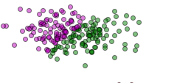
Solution methods
.
Description from the eligibility criteria
Text processing to remove all punctuations, white spaces, symbols
Tfidf and jaccard similarity is applied to the text
Aggolmerative clustering is applied.
Log(sample data)= number of clusters is used to determine number of clusters for each patient dynamically.

Slide 4
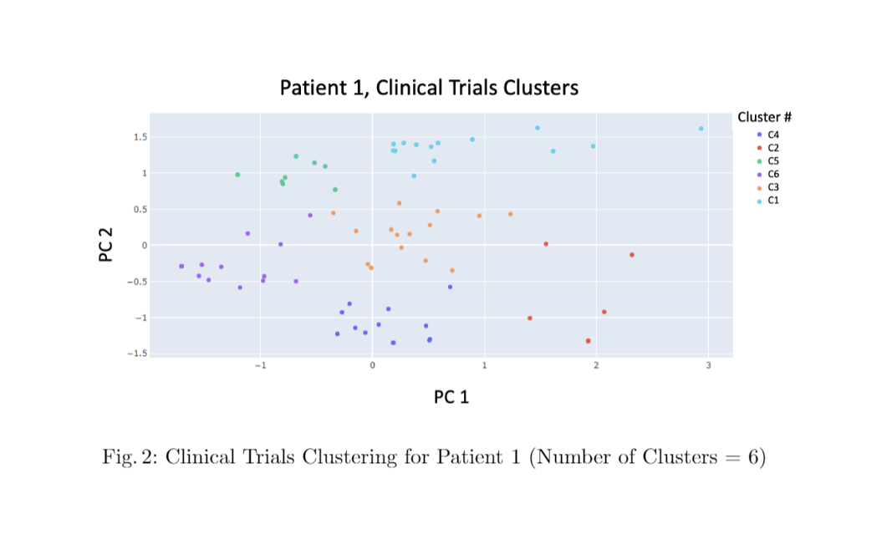
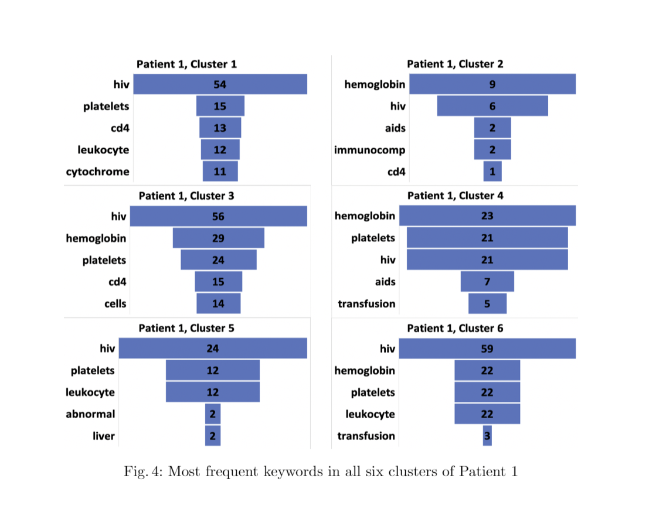
Visualization results
.

